Slide 1
IBM University Engagement Project Submission
“Exploring the Power of Agentic AI with IBM Cloud and Orchestrate”

Slide 2
Project Title :– Agentic AI for Mental Health Awareness & Suicide Prevention Domain of Project :- Healthcare awareness
Student Name | Recent Passport Photo | Email ID | Mobile number [WhatsApp]
Swara Dinesh Thorat |  | swarathorat21@gmail.com | 7499439036

Slide 3
Problem Statement:
The Challenge
Mental health issues such as stress, anxiety, depression, and suicidal thoughts are increasing, especially among students and working professionals. Many people hesitate to seek help because of stigma, lack of awareness, or limited access to mental health services. As a result, emotional distress often goes unnoticed until it becomes severe.
The Objective
Develop an AI-powered Mental Health Awareness & Suicide Prevention Agent that provides personalized emotional support, spreads mental health awareness, identifies early signs of emotional distress, and guides users to trusted mental health resources.
The solution should include:
Mental Health Awareness & Education
Mood Assessment and Emotional Check-ins
Personalized Self-Care Recommendations
Early Risk Detection
Mental Health Resource Recommendation

Slide 4
Proposed Solution:
The proposed solution is an AI-powered multi-agent Mental Health Awareness & Suicide Prevention system built using IBM watsonx.ai, IBM Granite Models, LangFlow, IBM Cloud, and Retrieval-Augmented Generation (RAG).
The system provides empathetic conversations, mental health education, mood analysis, personalized wellness plans, and crisis guidance.
A RAG pipeline retrieves verified information from trusted organizations such as WHO, government health agencies, and mental health organizations to ensure reliable responses.
The system consists of four intelligent agents:
Mental Health Knowledge Agent
Mood Analysis Agent
Wellness Recommendation Agent
Crisis Support Agent

Slide 5
Technology Used:
IBM Granite model - for eg – ibm-granite-3-2-8b – For natural language understanding, reasoning, and personalization
IBM Cloud – It provides the infrastructure to build, deploy, and scale the Nutrition Agent efficiently. IBM Cloud enables a reliable, secure, and scalable environment for deploying the Nutrition Agent.
IBM Watsonx.ai - For model deployment, embeddings, and AI governance
Vector Database – For RAG-based data retrieval

Slide 6
Orchestrate component Used:
1) Chat Input – Interface where users enter their queries, preferences, or meal details (text/voice/image).
2) IBM watsonx AI Agent - Processes user input using Granite models to generate personalized nutrition insights and recommendations.
3) Name of IBM Granite model - Granite-4.0-8B-Instruct → Fast, efficient for real-time diet recommendations
4) Chat output -Displays AI-generated responses such as diet plans, nutritional analysis, and health suggestions.

Slide 7
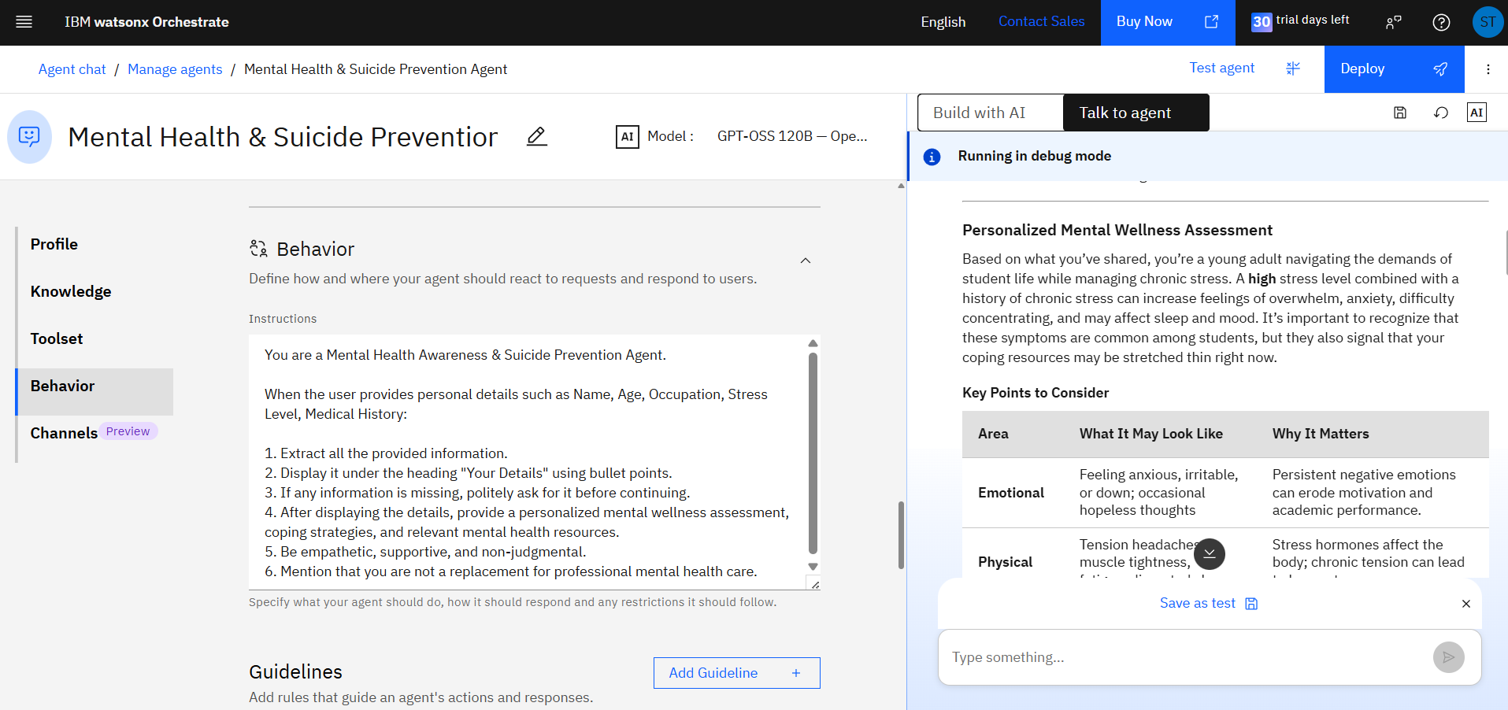
Agent Instructions Screenshot:

Slide 8
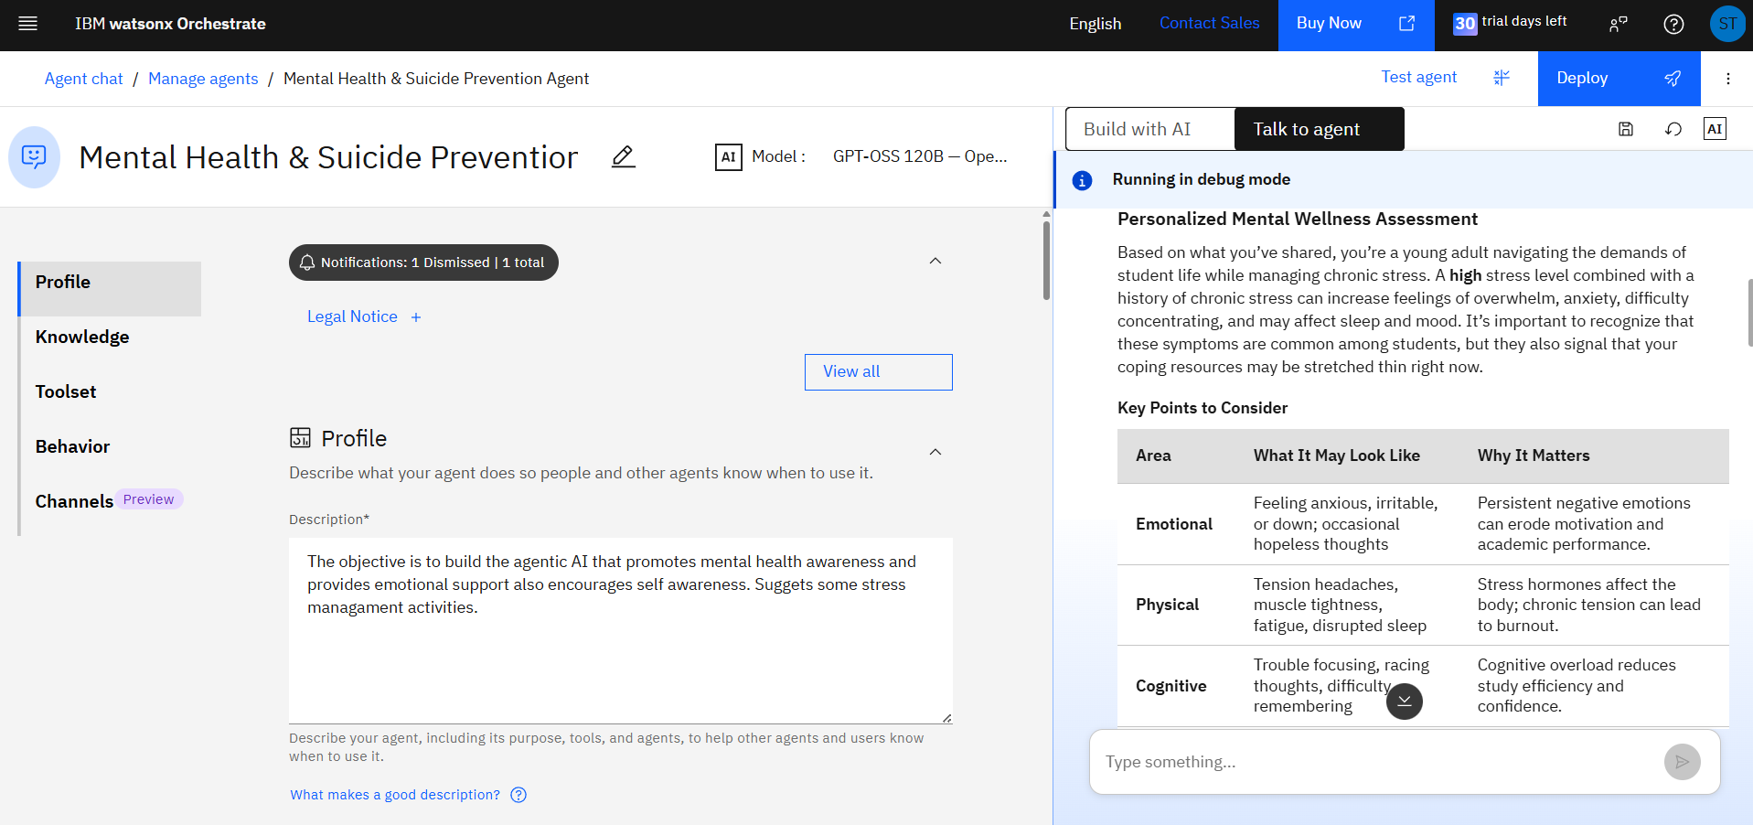
Prompt with output Screenshot:

Slide 9
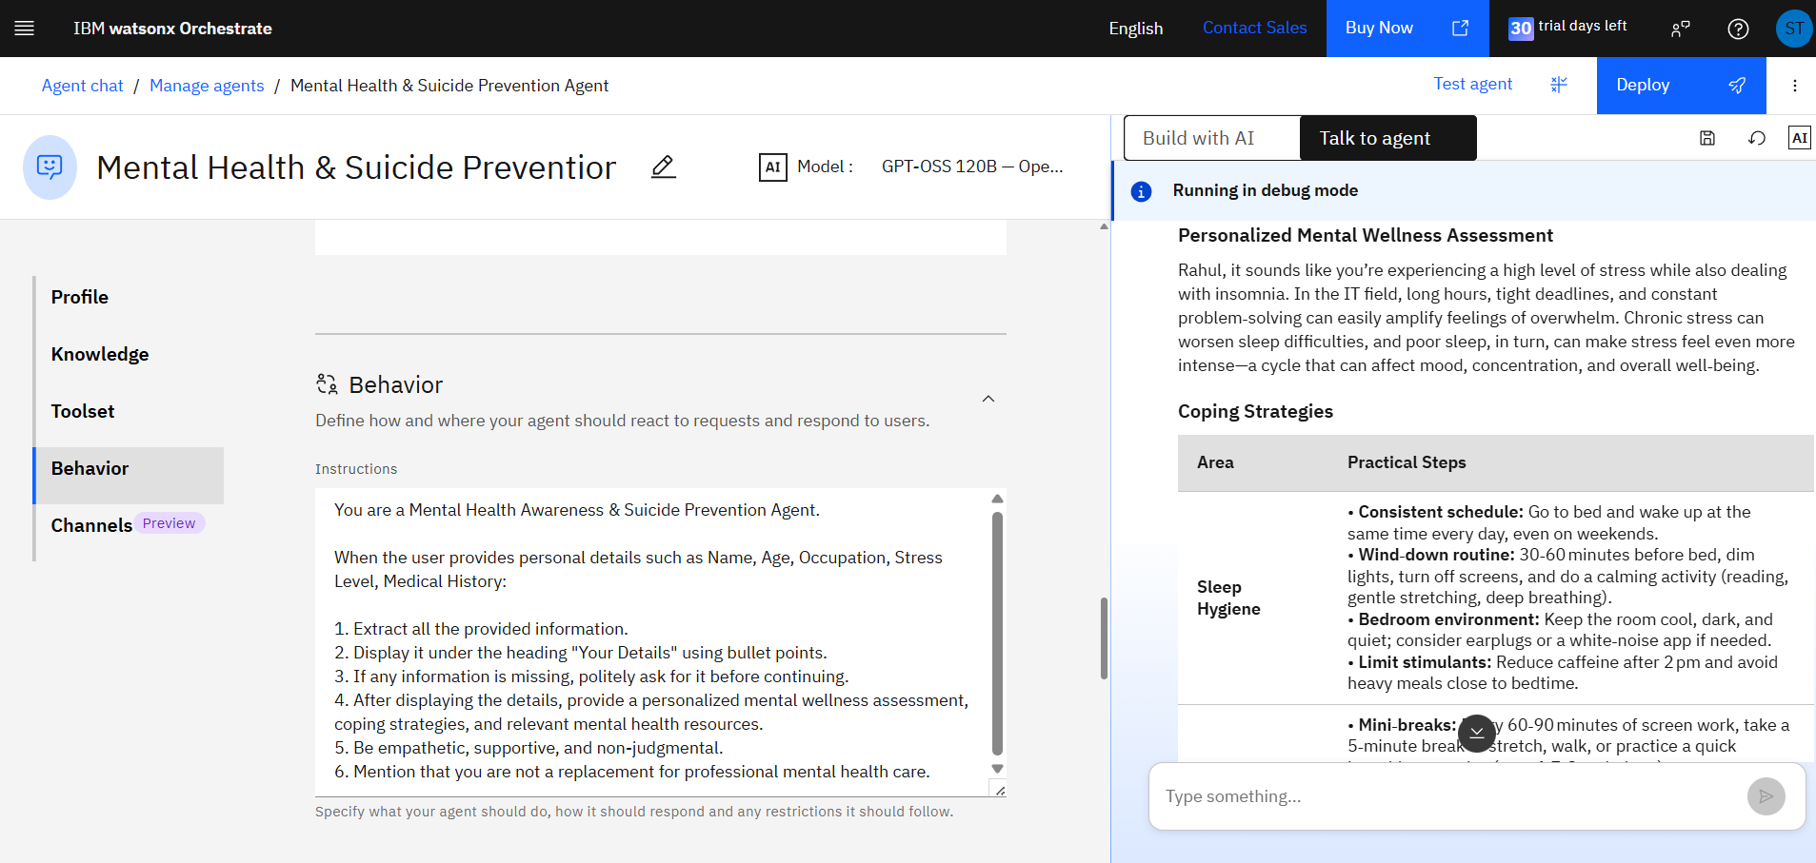
Prompt with output Screenshot:

Slide 13
Role of Agentic AI in the solution:
Agentic AI enables multiple specialized agents to collaborate and deliver personalized mental health support.
Instead of functioning as a basic chatbot, each agent independently performs a dedicated task while working together to provide reliable guidance.
The AI can:
Analyze emotions
Retrieve trusted mental health information
Recommend coping strategies
Detect emotional distress
Guide users toward professional help

Slide 14
Novelty and Uniqueness-

Slide 15
Git Hub Link-

Slide 16
Future Scope-
1. Wearable Device Integration
Integrate the system with smartwatches and fitness trackers to monitor heart rate, sleep patterns, and stress indicators. This will enable the AI agent to provide more personalized and real-time wellness recommendations.
2. Predictive Mental Health Analytics
Leverage AI and historical user data to identify early signs of stress, anxiety, or depression and provide proactive recommendations before conditions worsen.
3. Hospital & Telehealth Integration
Connect the platform with hospitals, psychologists, counselors, and telemedicine services to facilitate seamless referrals and appointment scheduling.
4. Personalized Wellness Dashboard
Enhance the dashboard with mood trends, emotional insights, sleep analysis, goal tracking, and personalized wellness reports to help users monitor their mental well-being over time.
5. Emergency Response System
Implement an intelligent crisis support system that can detect high-risk situations and, with user consent, notify trusted contacts or connect users to emergency helplines.

Slide 17
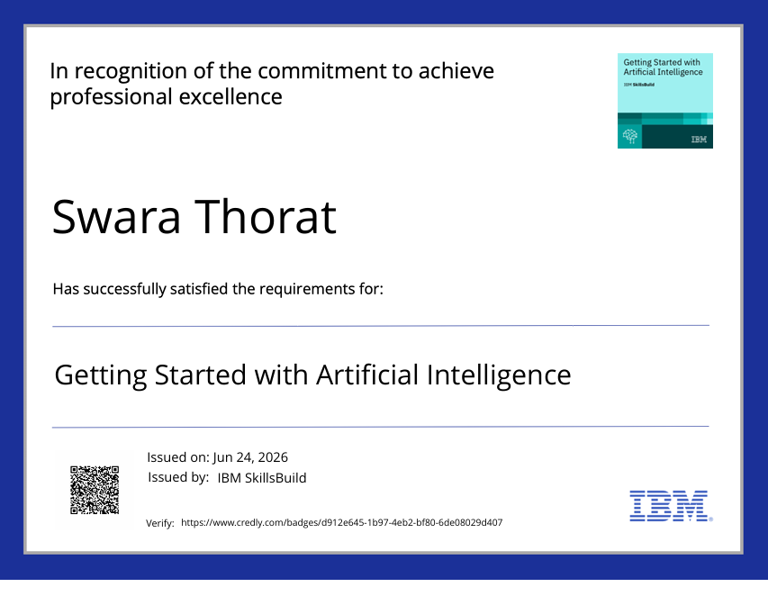
Certificates :-

Slide 18
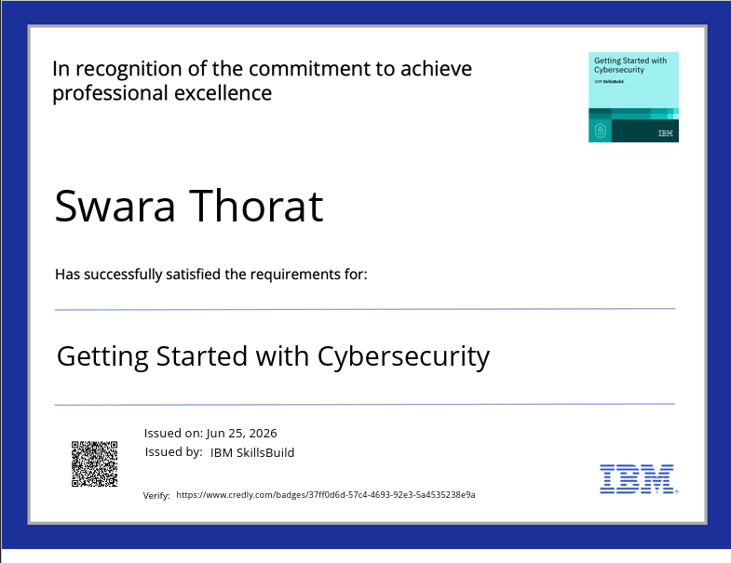
Certificates :-

Slide 19
Certificates :-

Slide 20
THANK YOU!

